Slide 1

ALTA 3G Cellular Gateway

Slide 2
Introduction
The ALTA 3G Cellular Gateway allows your Monnit Wireless Sensors to communicate with the iMonnit Online Wireless Sensor Monitoring and Notification System via cellular transmission.
This is the perfect solution for remote locations, or where an existing internet connection is not an option.
The ALTA Cellular Gateway is an advanced all wireless M2M gateway that enables fast time-to-market solutions for a wide range of M2M applications.
The ALTA Cellular Gateway is based on the latest Dualband CDMA wireless engine and comes integrated with Monnit’s wireless access point network (WAN) for use with all Monnit wireless sensors.
Monnit’s ALTA Cellular Gateway is specifically designed to respond to the increasing market need for global technology that accommodates a variety of vertical M2M application segments and remote wireless sensor management solutions.

Slide 3
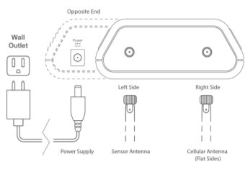
How to Setup
Use the QR code download the iMonnit app. Alternatively, you can search for iMonnit in Google Play or the Apple Store.
Follow the in-app instructions to add devices to your account.
Connect your power cord to the front and antennas to the back of the gateway as seen in the diagram.
You can view sensor data and customize your sensor settings in the app or online at imonnit.com.

Slide 4
Example Applications
Remote Location Monitoring
Shipping and Transportation
Agricultural Monitoring
Vacant Property Management
Vacation Home Property Management
Construction Site Monitoring
Data Centre Monitoring

Slide 5
Features
Wireless range of 1,200+ feet through 12+ walls
Frequency Hopping Spread Spectrum (FHSS)
Improved interference immunity
Encrypt-RF Security (Diffie-Hellman Key Exchange + AES-128 CBC for sensor data messages)
50,000 sensor message memory
Over the air updates (future proof)
True plug & play, no hassles for internet configuration set-up
No PC required for operation
Low-cost cellular service packages
Local status LEDs with transmission and online status indicators
AC power supply
Optional 24 hour battery backup in event of power outage

